Slide 1


Task 2
Youtube Channel Performance Analysis
Start Slide
Team 12 Presentation
Team Lead : Snigdha Gaur
Team Members : Arpita Sharma
Shakthi M
Vishesh Parashar

Slide 2


Data Collection and Preparation
Tools Used :
Excel – Collection
MySQL- Database
Query Language Used :
SQL – Extracting Data and Manipulations
Chef Prateek’s Kitchen Channel

Slide 3


Dataset Identification & Collection
Dataset Source : Chef Prateek’s Youtube Channel (Internal Real Time Dataset)
No. of Months: 6 Months – Jan 2025 to June 2025
Excel File with 2 sheets : youtube_videos and youtube_shorts.
Columns : Title, Upload Date, Upload Day, Views, Likes, Comments etc.
CSV FILE :
Data Saved as : youtube_videos.csv and youtube_shorts.csv
Deliverable : Clean, Structured CSV files. .

Slide 4
n
XLSX format excel file conversion to CSV file
Why conversion of xlsx to csv required??
COMPATIBILITY WITH SQL AND SCRIPTING :
.CSV files are plain text, making them easy to import to SQL databases using commands
Tools like MySQL, PostgreSQL, and Pandas handle .csv natively and more efficiently than.xlsx.
FASTER AND LIGHTWEIGHT:
.csv is lightweight and loads faster because it doesn’t store formatting, charts, or extra metadata like .xlsx .
CLEANER STRUCTURE FOR PARSING
.csv stores raw data in a structured row-column format, making it simpler for tools to parse without worrying about merged cells, hidden rows, or Excel formulas.

Slide 5
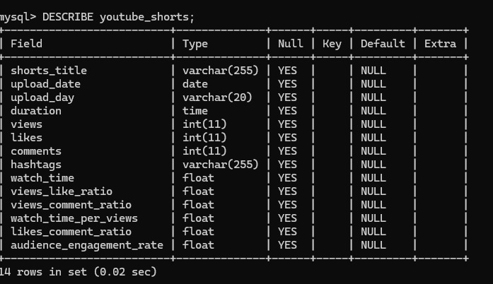
Database & Table Setup
Created MySQL Database : chef_prateek_yt
Tables Created : youtube_videos, youtube_shorts
Used MySQL 5.7 & Command Prompt with --local-infile=1
Data imported using LOAD DATA LOCAL INFILE command
Deliverable : Tables populated with cleaned data
Description of youtube_shorts

Slide 6
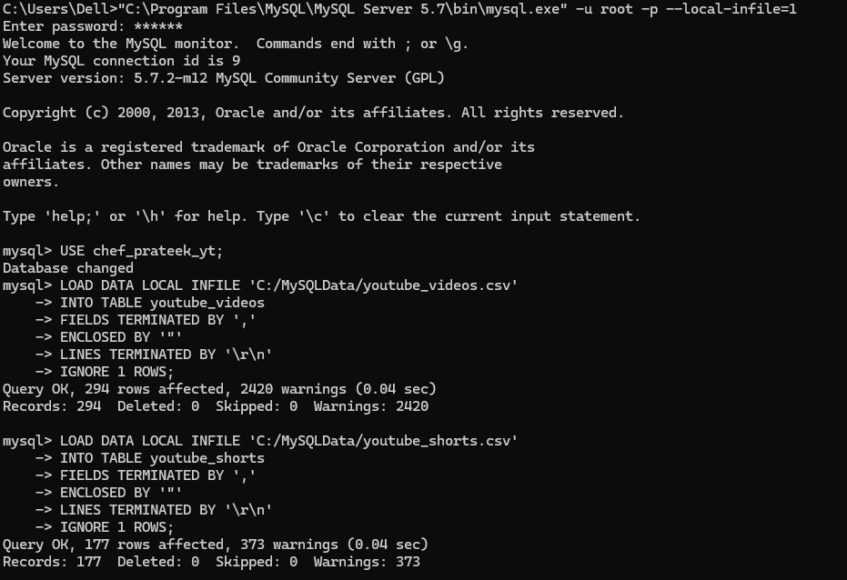
Command To Import .csv file data into MySQL

Slide 7

LOAD DATA LOCAL INFILE ‘C:/MySQL/youtube_videos.csv’
INTO TABLE youtube_videos
FIELDS TERMINATED BY ‘,’
ENCLOSED BY “”
LINES TERMINATED BY ‘\r\n’
IGNORE 1 ROWS;
Snippet of SQL Command used to load csv file- videos

Slide 8
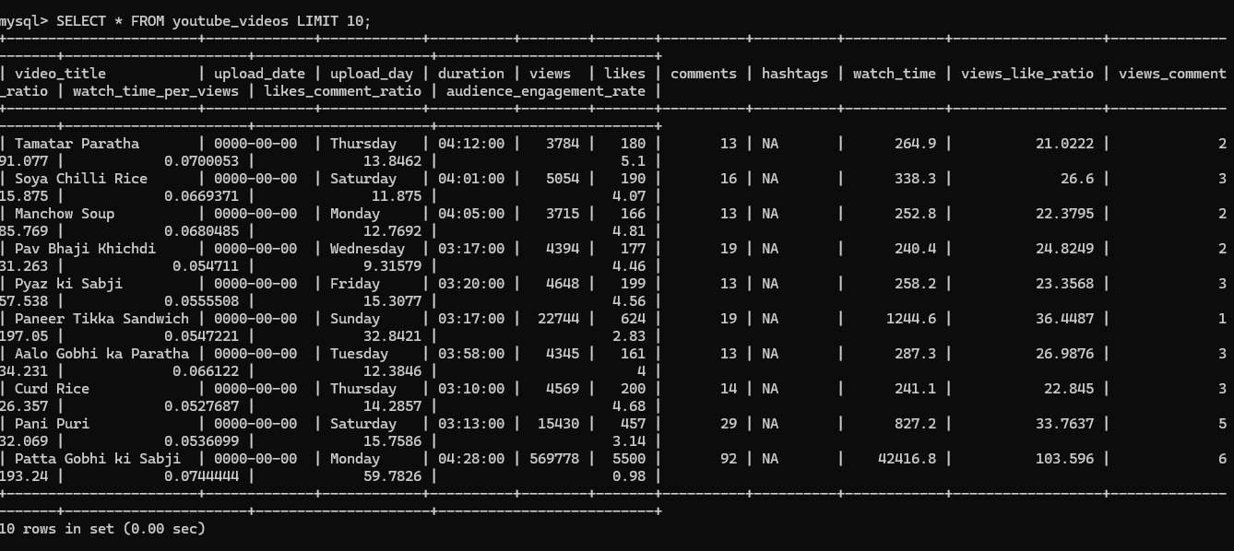

Output / SELECT * FROM youtube_videos LIMIT 10;

Slide 9
LOAD DATA LOCAL INFILE ‘C:/MySQL/youtube_shorts.csv’
INTO TABLE youtube_shorts
FIELDS TERMINATED BY ‘,’
ENCLOSED BY “”
LINES TERMINATED BY ‘\r\n’
IGNORE 1 ROWS;
Snippet of SQL Command used to load csv file -shorts

Slide 10
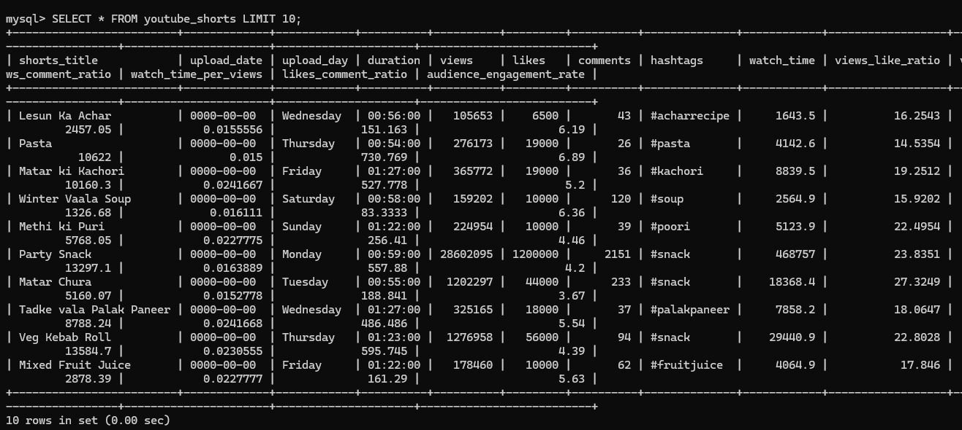
Output /SELECT * FROM youtube_shorts LIMIT 10;

Slide 11
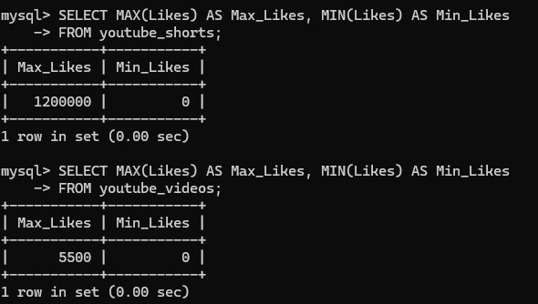
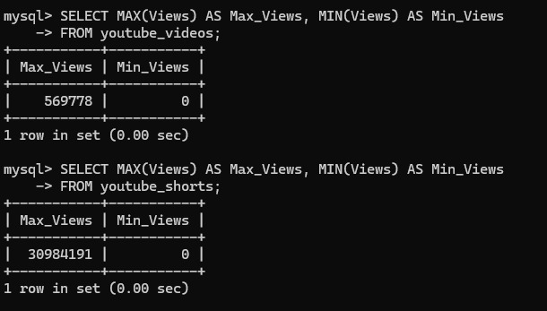
SQL Query to extract MAX and MIN Likes
SQL Query to extract MAX and MIN Views

Slide 12


Summary & Learnings
Converted Excel .xlsx to CSV format for structured import
Used MySQL terminal with advanced options for data loading
Resolved File Path, permission & syntax errors
Built a reliable SQL-ready dataset
Next Step : Profile and clean data for analysis

Slide 13

THANKYOU
TEAM 12
TEAM LEAD - SNIGDHA GAUR
TEAM MEMBER - ARPITA SHARMA
SHAKTHI M
VISHESH PARASHAR

